Slide 1
CAR Calibration Meeting CAR Review
AP Team C
Ronald Tse, Samantha Bang, Joe Lee, Catherine Qiu
December 03, 2015

Slide 2
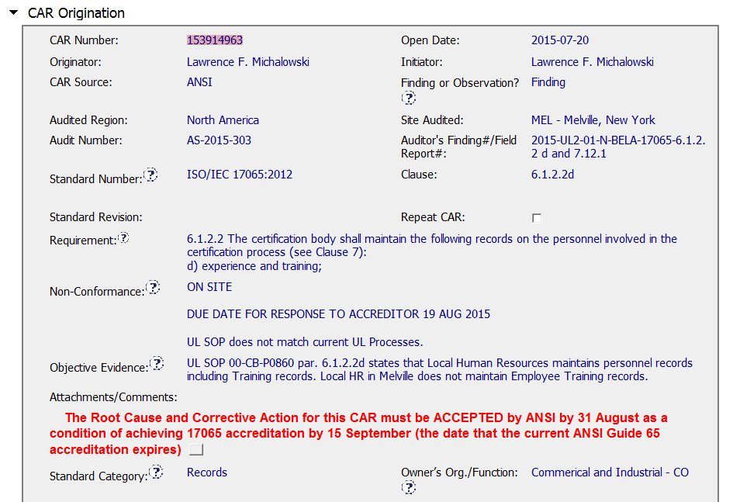
CAR 153914963
The due date was provided to show the target timeline.
The question is due to the conflict between the current operation and what specified in Quality document

Slide 3
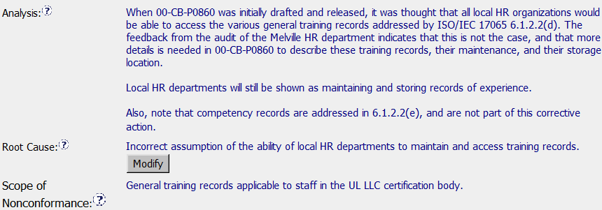
CAR 153914963
Excellent -
Clear and reasonable analysis to address the root cause.
Improvement -
The stakeholder involved analysis can be listed.
The widespread of NCR to local, regional or global should be clarified, depending on the cause and corrective action

Slide 4
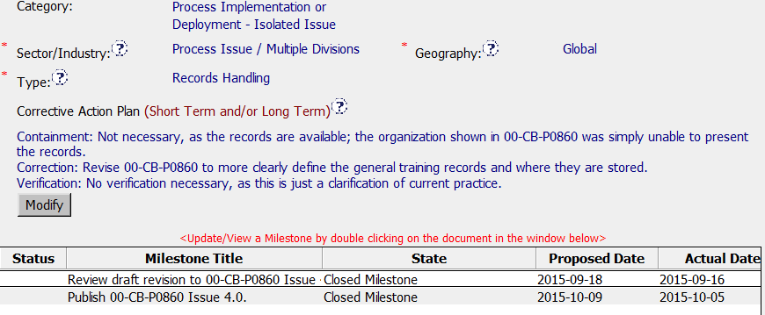
CAR 153914963
The selection Scope of Category, Type and Geography are suitable
Excellent -
To update the specification in Manual to meet the practiced operation, no containment and effectiveness verification is acceptable.
The justification why no containment and verification is reasonable.

Slide 5
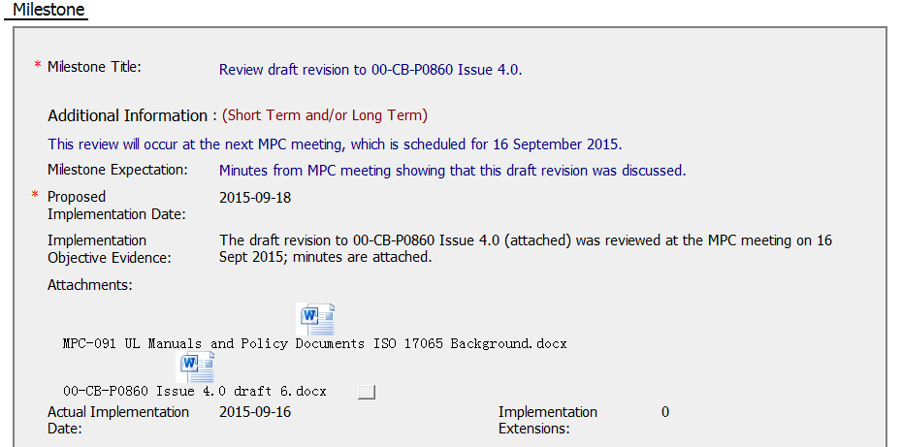
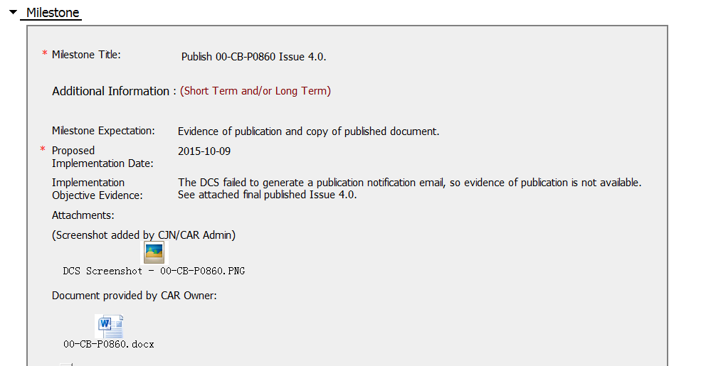
CAR 153914963
- The corrective actions are divided by 2 milestones
- Detailed description for action taken, and evidences provided.

Slide 6
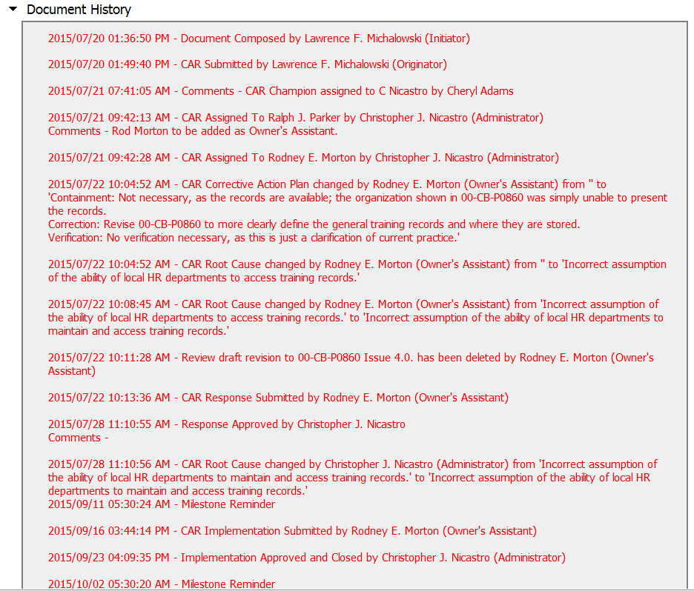
CAR 153914963
CAR responses submitted and reviewed on time within the timeframe

Slide 7
CAR 153914963
Additional comments
This is a example of handling a CAR related to the conflict between the specification in the Quality document and practiced operation.
On basic of compliance with accreditation standards, 2 corrective directions can be considered:
Adjust the quality document to meet the practiced operation
The document owner, process owner or other stakeholders will be involved and agreed.
B. Adjust the current operation to meet the quality document.
It might impact the ability and efficiency of operation

Slide 8
CAR 153914963 – CBS Check
CBS Requirements | Excellent | Moderate | Need Improve | N/A
(C) Extensions are within requirement (<30 days, 3 or less) | √
(T) Most appropriate ‘category’, ‘type’, ‘geography’ are selected | √
(P) Facilitates the handling of disputed CARs |  |  |  | √
(T) Acts on CARs within required timeframe | √
(C) Analysis shows clear path to root cause and scope; stakeholders identified |  |  | √
(C) Root cause statement is succinct, reasonable, complete (Shows ‘N/A’ for observations) | √
(C) Corrective actions fix the objective evidence and other problems found; address entire root cause and scope. For observations, they do not go beyond fixing the objective evidence | √
(C) Milestones address containment & owner’s verification; completed per milestone expectations |  | √
(P) Verification per requirements |  |  |  | √
(L) Referenced communications are attached as needed |  |  |  | √
(C L) Evidence of communication for overdue/escalated CARs and other pertinent concerns |  | √
(P) Trains other CAR Champions |  |  |  | √

Slide 9
Exemplary Finding CAR 153914334

Slide 10
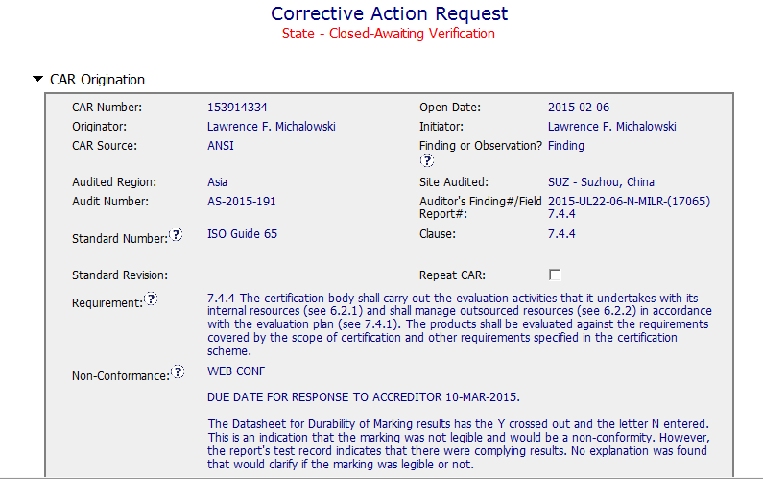
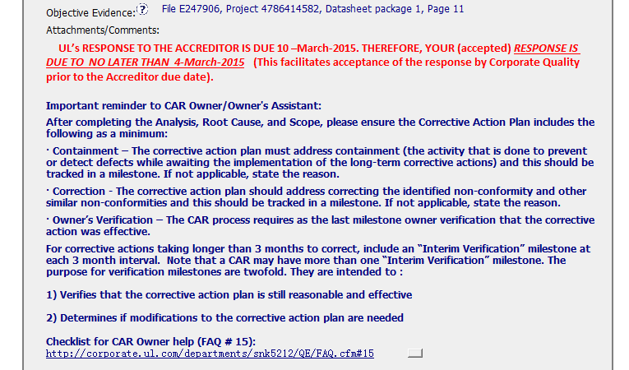
CAR 153914334
The non-conformance and evidence was descripted clearly.
“the important reminder to CAR owner” looks useful to guide CAR owner.
The due date was provided to show the target timeline.

Slide 11
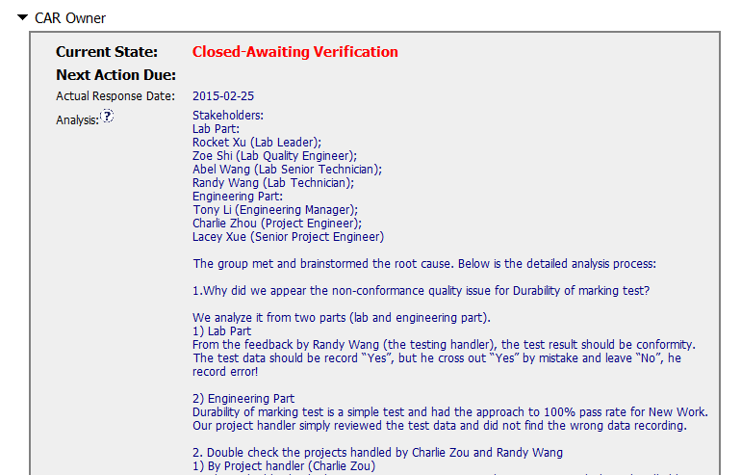
CAR 153914334
Stakeholders were identified with department and position title. It’s easy to know who involved the CAR and if the CAR owner get the right people involved.
Analysis was done for each part who involved in the project handling process.
Analysis includes whether the items were isolated incidents and indicates the project number which were checked

Slide 12
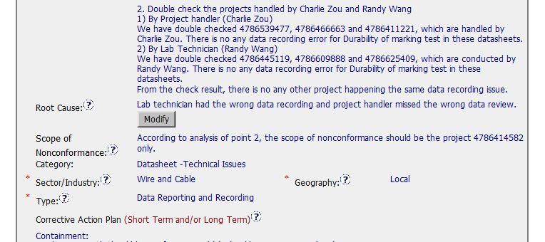
CAR 153914334
Analysis includes whether the items were isolated incidents and indicates what was checked
Root cause is based on the analysis.
Scope is identified based on the analysis. And most appropriate ‘category’, ‘type’, ‘geography’ are selected

Slide 13
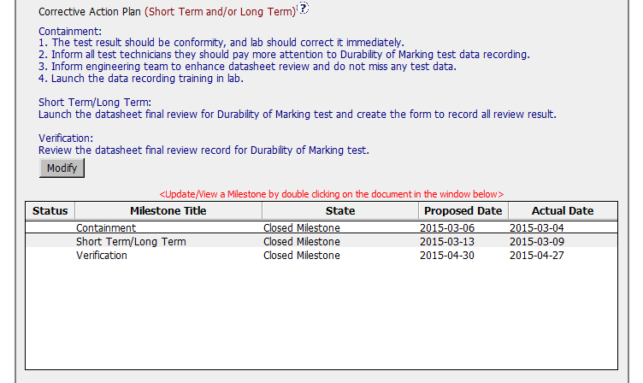
CAR 153914334
Containment, short term corrective action and verification were developed for each item.
Corrective actions fix the objective evidence and other problems found; address entire root cause and scope.
No more than 2 months for each milestone, and each milestone was completed before proposed date.

Slide 14
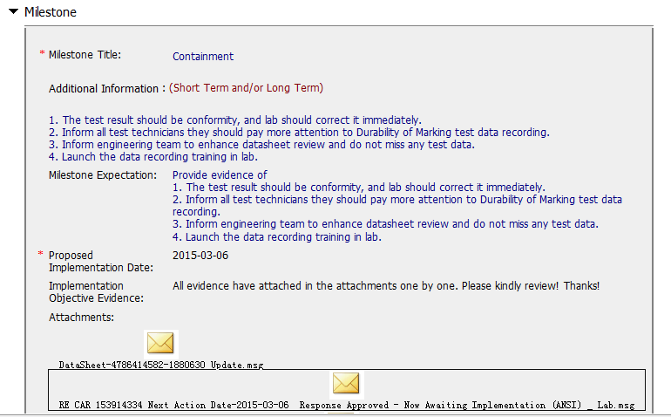
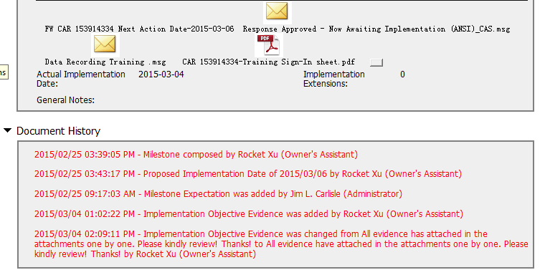
CAR 153914334
Milestones were established for each item. They all met the proposed due date.
Provided evidences as attachment for each action.

Slide 15
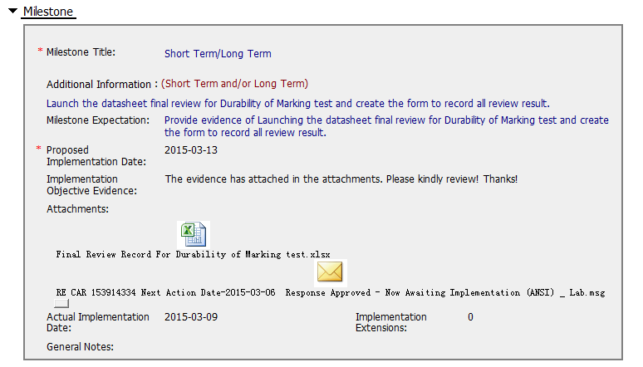
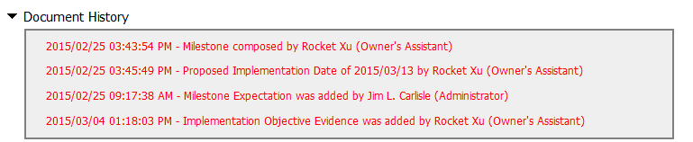
CAR 153914334
Implementation evidence were attached to prove the milestones one by one.

Slide 16
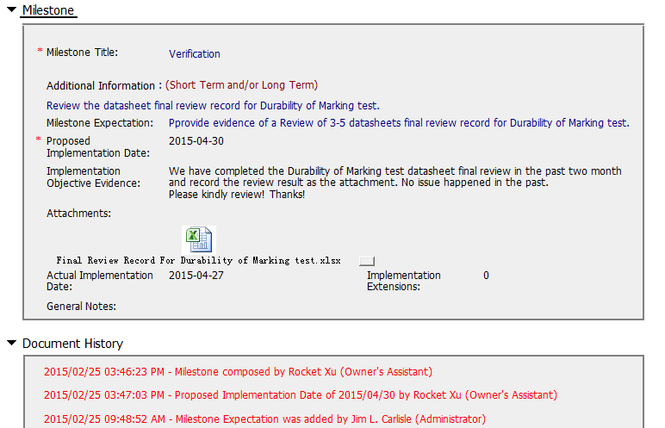
CAR 153914334
Owner’s verification per requirements

Slide 17
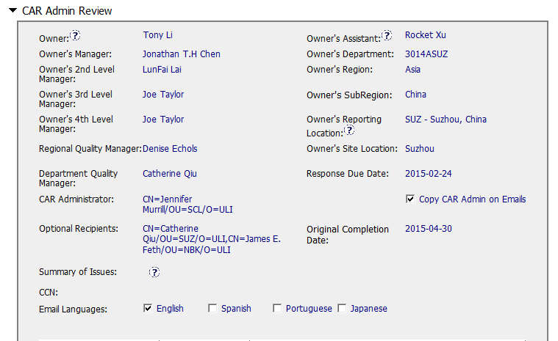
CAR 153914334
CAR Champion remembered changing president's name to Joe.

Slide 18
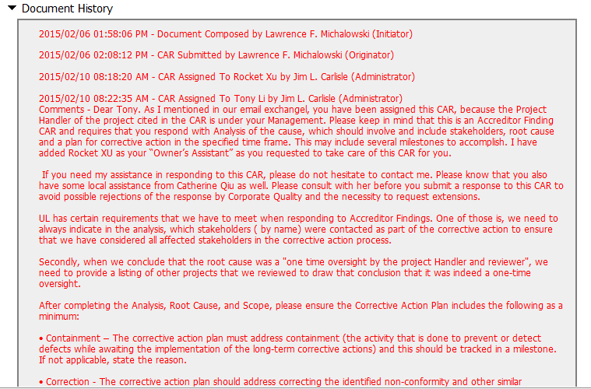
CAR 153914334
Very clear and detailed guidance to the owner, e.g. who he can get help, what the requirement of Analysis, Root cause, and scope, and containment correction, and reminder to avoid possible rejections, a pre-check is advised etc.

Slide 19
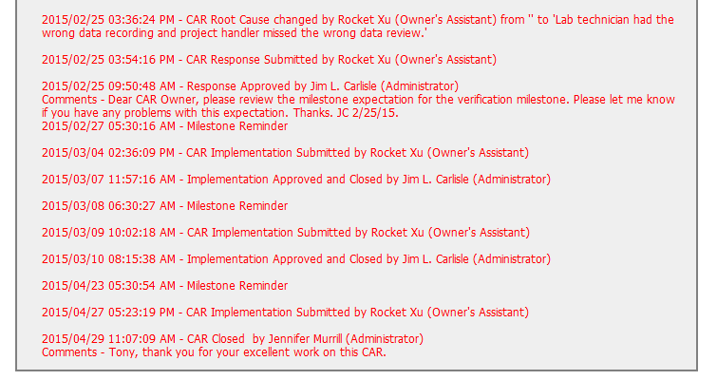
CAR 153914334
2
2
4
2
1. Acts on CARs within required timeframe, no overdue and escalation.
2. CAR champion approved CAR timely.
3. Express the recognition.
4. Supports other CAR Champions by serving as their backup when they are absent. Works as a team player with other CAR Champions. CAR champion changed from Jim to Jennifer.
3

Slide 20
CAR 153914334 – CBS Check
CBS Requirements | Excellent | Moderate | Need Improve | N/A
(C) Extensions are within requirement (<30 days, 3 or less) |  |  |  | √
(T) Most appropriate ‘category’, ‘type’, ‘geography’ are selected | √
(P) Facilitates the handling of disputed CARs |  |  |  | √
(T) Acts on CARs within required timeframe | √
(C) Analysis shows clear path to root cause and scope; stakeholders identified | √
(C) Root cause statement is succinct, reasonable, complete (Shows ‘N/A’ for observations) | √
(C) Corrective actions fix the objective evidence and other problems found; address entire root cause and scope. For observations, they do not go beyond fixing the objective evidence | √
(C) Milestones address containment & owner’s verification; completed per milestone expectations | √
(P) Verification per requirements | √
(L) Referenced communications are attached as needed | √
(C L) Evidence of communication for overdue/escalated CARs and other pertinent concerns |  |  |  | √
(P) Trains other CAR Champions |  |  |  | √

Slide 21
Team A Ken Berger, Jim Kurtz, Mark Lavine, Michael Schneider
Q4 CAR Champion Calibration
2015

Slide 22
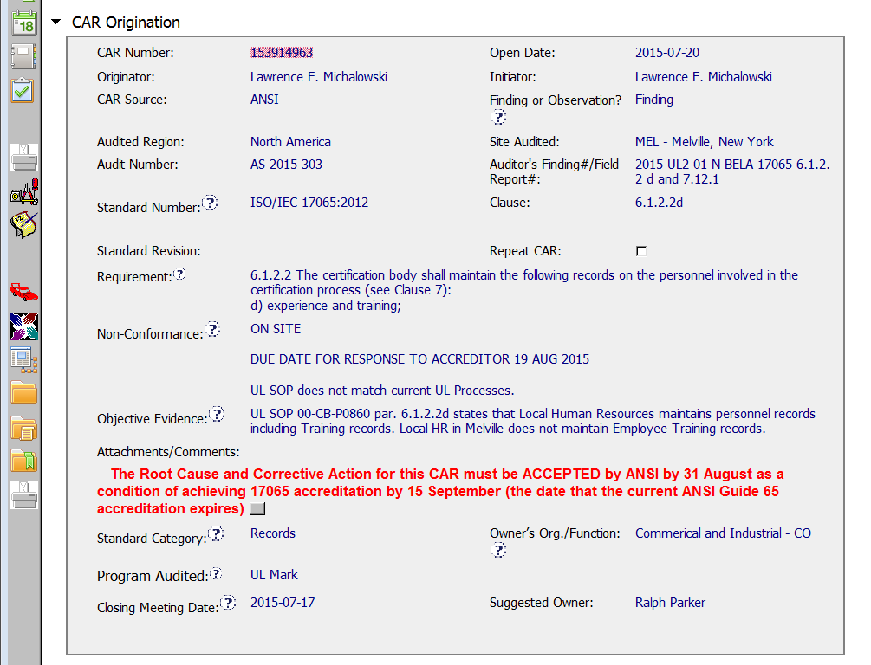
CAR# 153914963– Finding, Origination
Audit and Finding #s correlate with audit calendar & report
Clear Due date & reminder
Clear Due date & reminder

Slide 23
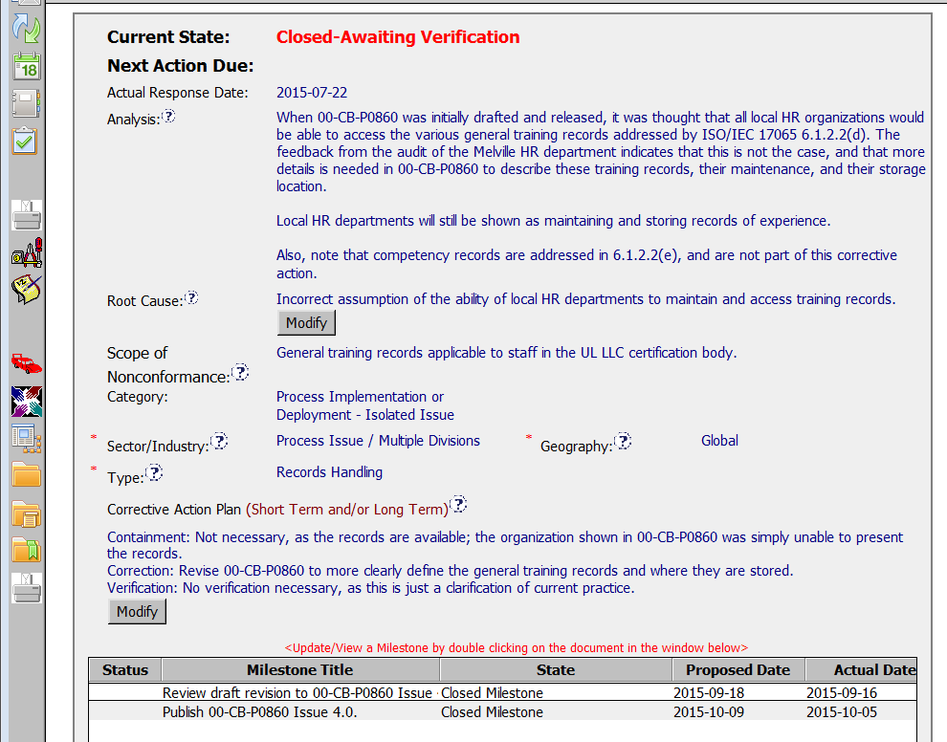
CAR# 153914963– Finding, Cause & Categories
No stakeholders
Response well ahead of due date.
Not really the root (e.g., why the incorrect assumption, how many other assumptions are we making).
Good ‘ type’.
Should geography be “Local” since this was considered ‘isolated’?

Slide 24
CAR# 153914963– Finding, Action Plan
Although owner said “no verification” there was a milestone.

Slide 25
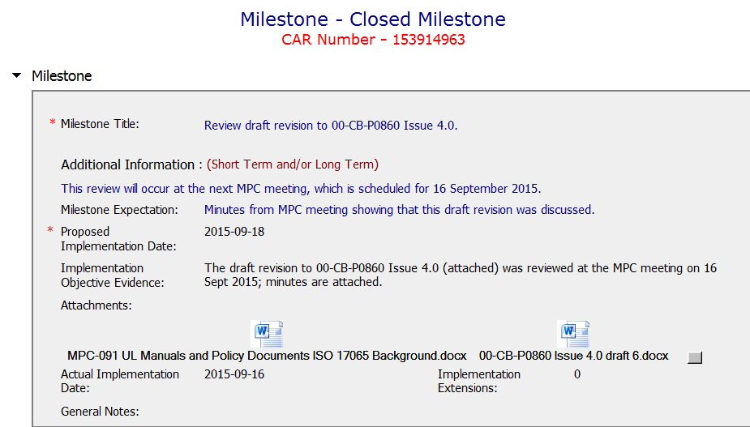
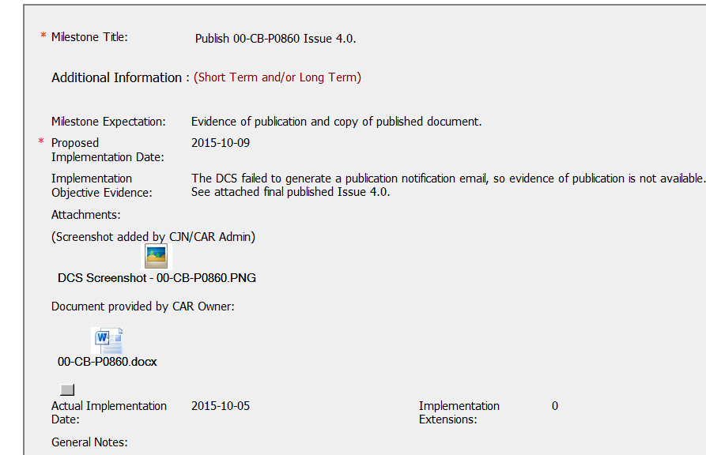
CAR# 153914963– Finding, Milestones …
Clear expectation & attachments meet the expectation.
Clear expectation & attachments meet the expectation.
Should address distribution of new revision also.

Slide 26
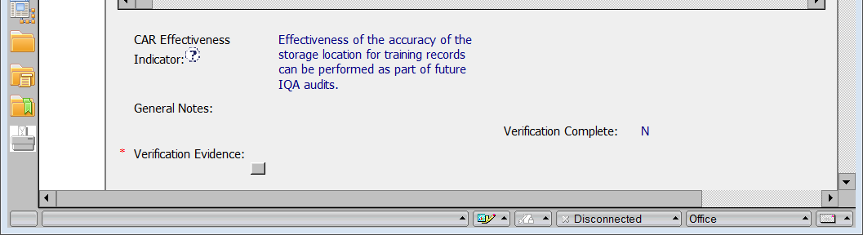
CAR# 153914963– Finding, Effectiveness…
Effectiveness addressed – SOP issue only.

Slide 27
CAR 153914559 – CBS Check
CBS Requirements | Excellent | Moderate | Need Improve | N/A
INTEGRITY
(C) Extensions are within requirement (<30 days, 3 or less) |  |  |  | X
(T) Most appropriate ‘category’, ‘type’, ‘geography’ are selected | X
(P) Facilitates the handling of disputed CARs | X |  |  | X
(T) Acts on CARs within required timeframe | X
COMPETITIVENESS
(C) Analysis shows clear path to root cause and scope; stakeholders identified |  |  | X
(C) Root cause statement is succinct, reasonable, complete (Shows ‘N/A’ for observations) |  |  | X
(C) Corrective actions fix the objective evidence and other problems found; address entire root cause and scope. For observations, they do not go beyond fixing the objective evidence | X
(C) Milestones address containment & owner’s verification; completed per milestone expectations | X
(P) Verification per requirements | X
COLLABORATION
(L) Referenced communications are attached as needed | X
(C L) Evidence of communication for overdue/escalated CARs and other pertinent concerns |  |  |  | X
(P) Trains other CAR Champions |  |  |  | X

Slide 28
Team B: Jeffery Lietz, Bruce Eng, Tovia Bat-Leah, Dale Hendricks; CARs 153914933, 153915322, 153915273 + one “exemplary”.

Slide 29
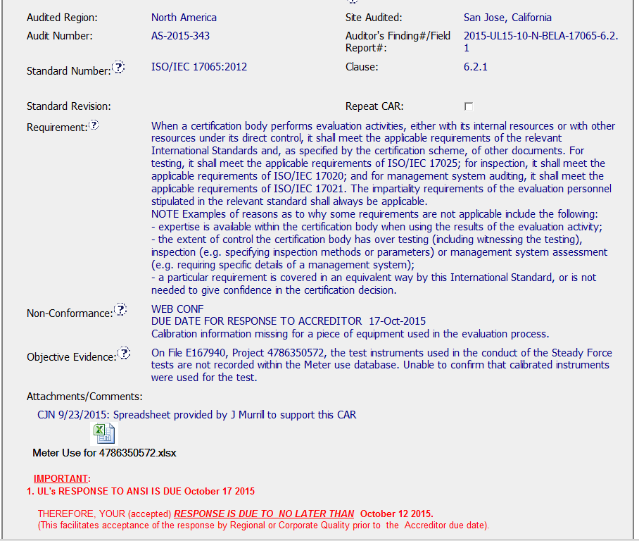
CAR 153915245
Clear nonconformance
Additional help to owner

Slide 30
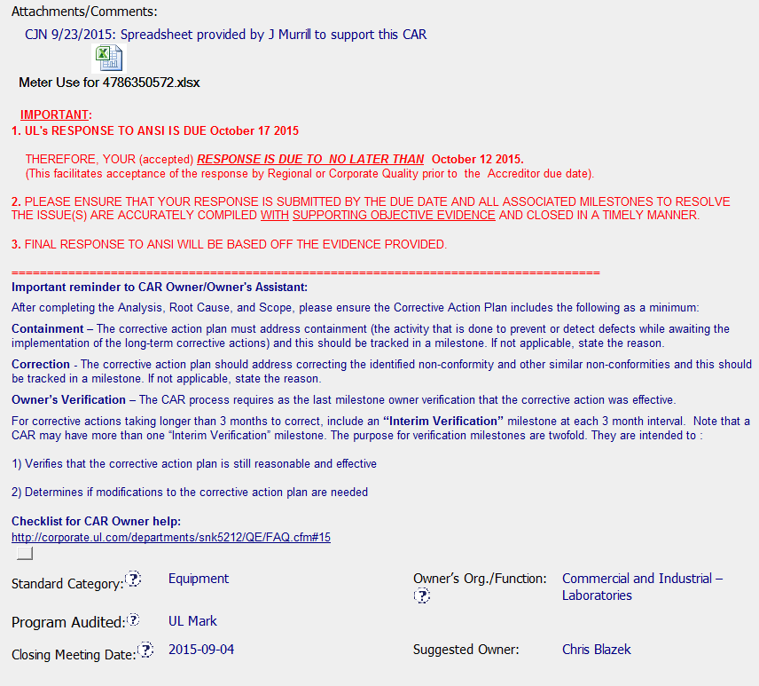
CAR 153915245
Clear communication of customer expectations
Should be: Local
Should be: Testing (Internal UL)
Appropriate Effectiveness Indicators

Slide 31
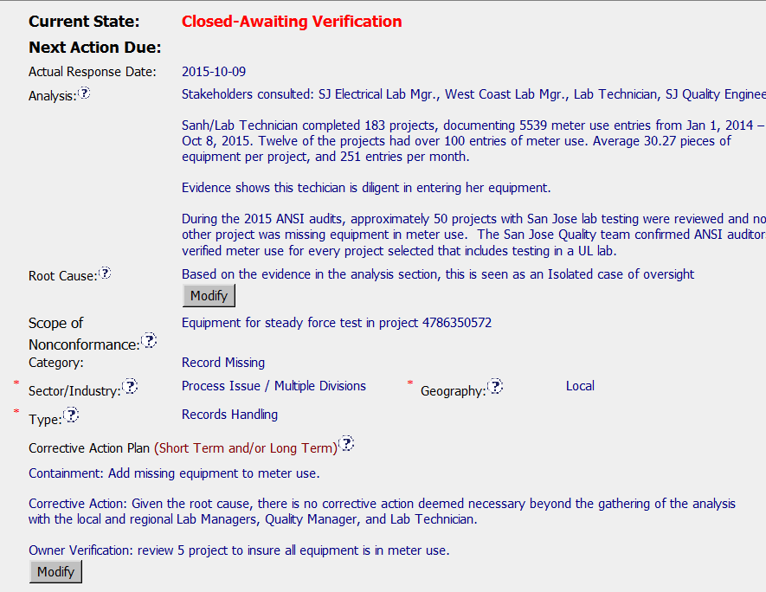
CAR 153915273 - Observation
Analysis is complete and includes all stake holders
Geography correct
Corrective action explains why only 2 milestones are needed

Slide 32
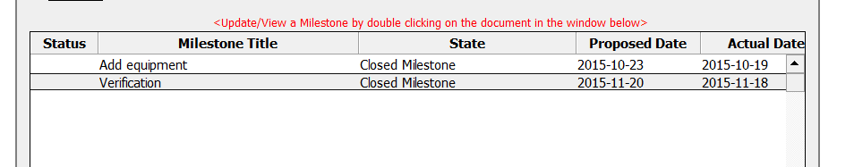
CAR 153915245
Milestones completed in timely manner

Slide 33
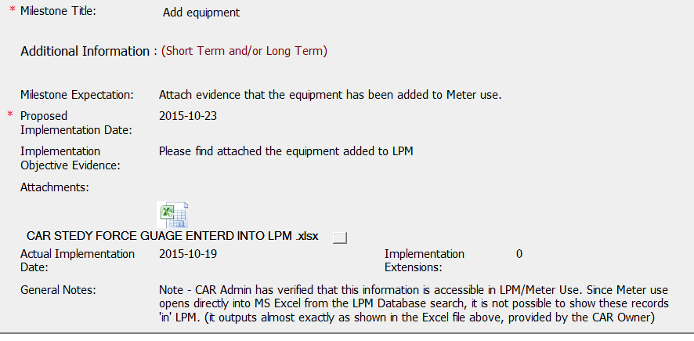
CAR 153915245
Good clarification by CAR champion in milestone closer.

Slide 34
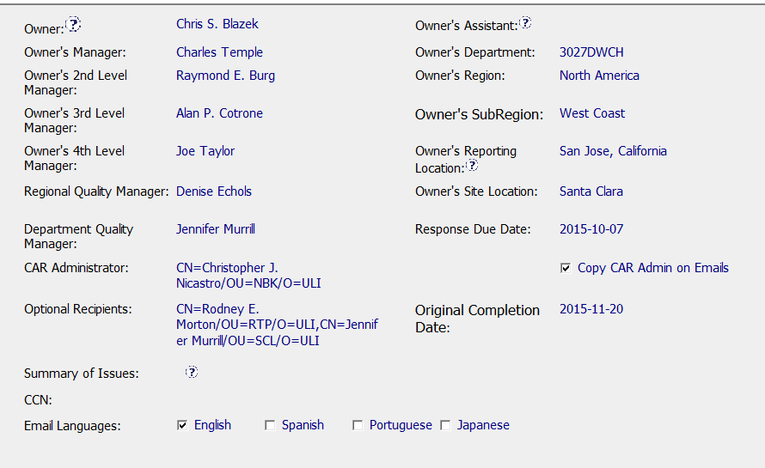
CAR 153915245
Removed VP’s from escalation chain.

Slide 35
CAR 153915245
CBS Requirements | Excellent | Moderate | Need Improve | N/A
INTEGRITY
(C) Extensions are within requirement (<30 days, 3 or less) |  |  |  | x
(T) Most appropriate ‘category’, ‘type’, ‘geography’ are selected | x
(P) Facilitates the handling of disputed CARs |  |  |  | x
(T) Acts on CARs within required timeframe | x
COMPETITIVENESS
(C) Analysis shows clear path to root cause and scope; stakeholders identified | x
(C) Root cause statement is succinct, reasonable, complete (Shows ‘N/A’ for observations) | x
(C) Corrective actions fix the objective evidence and other problems found; address entire root cause and scope. For observations, they do not go beyond fixing the objective evidence | x
(C) Milestones address containment & owner’s verification; completed per milestone expectations | X
(P) Verification per requirements |  |  |  | x
COLLABORATION
(L Referenced communications are attached as needed | x
(C L) Evidence of communication for overdue/escalated CARs and other pertinent concerns |  |  |  | x
(P) Trains other CAR Champions |  |  |  | x

